Slide 1
Overview on Socket API
Advisor: Cheng-Shang Chang

Slide 2
Socket Introduction
A network socket is a network interface- an endpoint of an interprocess communication flow across a computer network.
socket (domain, type, protocol)
determines which protocol behind the socket
application on
workstation 1
application on
workstation 2
socket
network & protocols
socket
Notes:
socket就是通訊連結的端點；socket提供了一個良好的介面，讓我們不需知道下層網路協定運作的細節便可以撰寫網路通訊程式。

Slide 3
Socket Structure
0-1023: well-know ports
1024-49151: registered ports
49152-65535: dynamic ports
http://en.wikipedia.org/wiki/ List_of_TCP_and_UDP_port_numbers
Struct in_addr{
in_addr_t s_addr;
}
struct sockaddr_in {
uint8_t sin_len;
sa_family_t sin_family;
in_port_t sin_port;
struct in_addr sin_addr;
char sin_zero[8];
};
Length
PF_INET
16-bit port#
32-bit IPv4 address
140.114.26.111
8 bytes unused
0~255: 8 bits
typedef uint16_t in_port_t;
typedef unsigned int uint16_t;
in_port_t : an unsigned integer type of exactly 16 bits.
typedef uint32_t in_addr_t;
typedef unsigned long int uint32_t;
in_addr_t : an unsigned long integer type of exactly 32 bits.

Slide 4
TCP Socket Programming

Slide 5


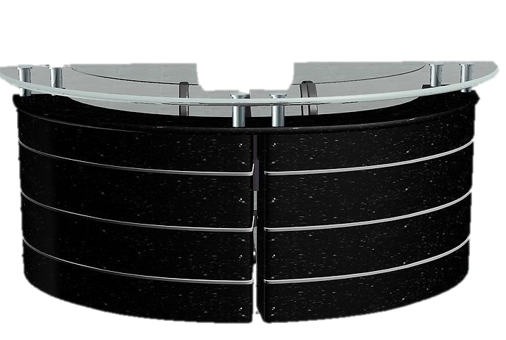


Notes:
Client/Server model
每個網路應用程式都有一個通訊端點，一種端點是用戶端，另一種是伺服器。

Slide 6
Flow Chart of TCP Setup
Client Side
Server Side
socket()
bind()
listen()
socket()
accept()
3-Way Handshake
Block process until connection from a client
connect()
write()
Data (Request)
read()
read()
write()
Data (Reply)
close
Notes:
要為socket命名，伺服器必須為socket位址結構設初始值並呼叫bind()函式，以指定本身連結埠號碼和IP位址，完成命名的工作。

Slide 7
The Server Side

Slide 8
Socket System Call
Server
Socket()
Bind()
application on
workstation 1
TCP/IP
myaddr.sin_family = PF_INET;
myaddr.sin_port = htons(5000);
myaddr.sin_addr.s_addr = htonl(INADDR_ANY);
sockfd = socket (PF_INET, SOCK_STREAM, 0);
bind (sockfd, (struct sockaddr *) &myaddr, sizeof(struct sockaddr_in));
listen (sockfd, 10);
addr_size = sizeof (client_addr);
while(1){
streamfd = accept (sockfd, (struct sockaddr *) &client_addr, &addr_size);
status = read (streamfd, str_buf, 100);
printf ("string from net: %s\n", str_buf);
close(streamfd);
}
socket

Slide 9

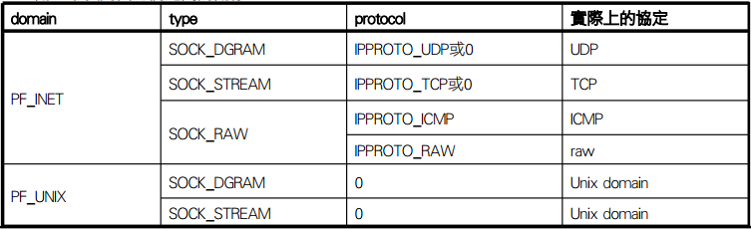
Create Socket Descriptor
socket() 建立socket，執行成功後回傳socket file descriptor
執行失敗回傳-1
socket() 三個參數介紹：
1.表示internet協定
2.連結的型態(TCP, UDP…)
3.通訊協定
Application
PF_INET
SOCK_STREAM
0
UDP TCP
IP
Notes:
依據socket所提供的服務來將它分類，然而在用戶端和伺服器上的這兩個sockets必須是同一類才能互相通訊，也就是說，他們必須都是stream(TCP)或都是datagram(UDP)。用戶端的應用程式必須要能找到並識別伺服器的socket，而伺服器會將它的socket命名以讓用戶端識別，就TCP/IP而言，一個socket name包括了IP位址、連結埠編號、以及協定本身。

Slide 10
Bind System Call and IP-address Setup
Server
struct sockaddr_in myaddr, struct sockaddr_in client_addr;
myaddr.sin_family = PF_INET;
myaddr.sin_port = htons(5000);
myaddr.sin_addr.s_addr = htonl(INADDR_ANY);
sockfd = socket (PF_INET, SOCK_STREAM, 0);
bind (sockfd, (struct sockaddr_in *) &myaddr, sizeof(struct sockaddr_in));
listen (sockfd, 10);
addr_size = sizeof (client_addr);
while(1){
streamfd = accept (sockfd, (struct sockaddr *) &client_addr, &addr_size);
status = read (streamfd, str_buf, 100);
printf ("string from net: %s\n", str_buf);
close(streamfd);
}
Socket()
…
setup address
Bind()
Listen()
bind the server port and address
Notes:
要為socket命名，伺服器必須為socket位址結構設初始值並呼叫bind()函式，以指定本身連結埠號碼和IP位址，完成命名的工作。

Slide 11
Byte Ordering Functions
short x=13; //16-bit integer
long y = ;
Little Endian
Big Endian
INTEL
CPU
…
…
TCP/IP Software uses Big Endian.
Network Byte Order
…
…
x
13
x
0
0
13
…
…
…
…
…
…
1
192
y
2
y
168
168
2
192
1
…
…

Slide 12
Byte Ordering Function
struct sockaddr_in myaddr;
myaddr.sin_port = 13;
Network recognize the port number as 13*256+0*1;
Byte ordering function
uint16_t htons(uint16_t host16bitvalue);
uint32_t htonl(uint32_t host32bitvalue);
Return value in network byte order
uint16_t ntohs(uint16_t net16bitvalue);
Uint32_t ntohl(uint32_t net32bitvalue);
Return value in host byte order
this is not correct;
Little Endian
Big Endian
INTEL
CPU
…
…
TCP/IP Software uses Big Endian.
Network Byte Order
…
…
x
13
x
0
0
13
…
…
…
…
…
…
1
192
y
2
y
168
168
2
myaddr.sin_port = htons(13);
192
1
…
…

Slide 13
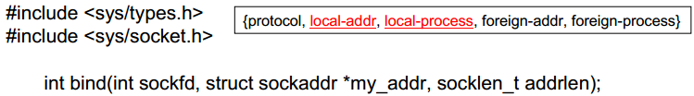
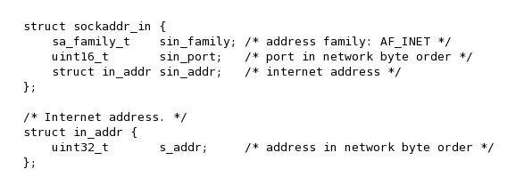
bind()
bind() 將sockaddr結構連結到所建立的socket，當有封包抵達網路介面時，Linux核心便會將此封包導向到其連結的socket。
bind() 三個參數介紹：
1. socket()執行後傳回的socket descriptor
2. 指向socket sockaddr_in結構的指標，用來存放連結的sockaddr位址結構
3. 第二個參數的位址結構長度
IP address設定為INADDR_ANY，
表示可 以接受任何Client主機的服務要求
Sockaddr_in
sa_family (e.g. PF_INET)
port#(e.g. 13)
address (e.g. INADDR_ANY)
Application(socket)
Sockfd
buffer
The starting memory
address of the buffer
length

Slide 14
Listen Connection
Bind()
myaddr.sin_family = PF_INET;
myaddr.sin_port = htons(5000);
myaddr.sin_addr.s_addr = htonl(INADDR_ANY);
sockfd = socket (PF_INET, SOCK_STREAM, 0);
bind (sockfd, (struct sockaddr *) &myaddr, sizeof(struct sockaddr_in));
listen (sockfd, 10);
addr_size = sizeof (client_addr);
while(1){
streamfd = accept (sockfd, (struct sockaddr *) &client_addr, &addr_size);
status = read (streamfd, str_buf, 100);
printf ("string from net: %s\n", str_buf);
close(streamfd);
}
Listen()
Accept()

Slide 15

listen()開始監聽連線請求
listen()：監聽socket connections 和限制接收連線 queue的個數。
listen()兩個參數介紹：
1. socket()執行後傳回的socket descriptor
2. 可以接受對該socket進行連線請求的個數(queue size)
Return value: 0 success, -1 error
每一個connection request會被accept()處理，尚未處理的connection request 會放入queue中等待，當queue滿時會產生connection refused。

Slide 16
Accept Connection
Bind()
myaddr.sin_family = PF_INET;
myaddr.sin_port = htons(5000);
myaddr.sin_addr.s_addr = htonl(INADDR_ANY);
sockfd = socket (PF_INET, SOCK_STREAM, 0);
bind (sockfd, (struct sockaddr *) &myaddr, sizeof(struct sockaddr_in));
listen (sockfd, 10);
addr_size = sizeof (client_addr);
while(1){
streamfd = accept (sockfd, (struct sockaddr *) &client_addr, &addr_size);
status = read (streamfd, str_buf, 100);
printf ("string from net: %s\n", str_buf);
close(streamfd);
}
Listen()
Accept()

Slide 17
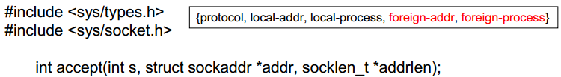
accept()處理新連線
accept()用來處理連線請求，只有在TCP的server端呼叫。
accept() 三個參數介紹：
1. socket()執行後傳回的socket descriptor
2.指向struct sockaddr_in結構的指標，用來存放client端的IP address 3. 第二個參數的長度
當連線成功傳回client的socket descriptor，失敗則回傳 -1。
會從queue中拿取第一個connection request來處理，他會建立一個新
的socket descriptor為之後用來操作該連線所用。
當queue中沒有connection request時，該函式預設會讓process block。

Slide 18
The Client Side

Slide 19
Connect to Server
Socket()
Connect()
Write()
struct sockaddr_in server_addr;
int sockfd, status;
//setup the server address
server_addr.sin_family = PF_INET;
server_addr.sin_port = htons(5000);
server_addr.sin_addr.s_addr = inet_addr ("127.0.0.1");
//connect to the server
sockfd = socket (PF_INET, SOCK_STREAM, 0);
connect (sockfd, (struct sockaddr *) &server_addr, sizeof(struct sockaddr_in));
status = write (sockfd, "Hello!", strlen("Hello")+1);
close(sockfd);

Slide 20

connect()連線到另一端的Socket
TCP client端建立socket後，可用connect()向TCP server端要求建立連線，在確定連線後，client端和sever端就能開始互相傳送資料。
connect() 三個參數介紹：
1. socket()執行後傳回的socket descriptor
2.指向struct sockaddr_in結構的指標，用來存放server 的address
3. 第二個參數的位址結構長度
Return value: 0 success, -1 error

Slide 21
read/write()
application on
workstation 1
application on
workstation 2
socket
network
socket
HD
HD
#include <unistd.h>
ssize_t read(int sockfd, void *buf, size_t count);
read() ： attempts to read up to count bytes from socket file descriptor
sockfd into the buffer starting at buf.
If count is zero, read() returns zero and has no other results.
If count is greater than SSIZE_MAX, the result is unspecified.
read() 三個參數介紹：
1. (server side) accept()成功傳回client的socket descriptor (client side) socket()執行後傳回的socket descriptor
2.指向字元暫存器的指標，用來存放讀取到的資料
3. 欲接收的資料量長度
Success: the number of total bytes, failed: -1
#define SSIZE_MAX LONG_MAX
#define LONG_MAX 0x7FFFFFFFL
Notes:
在32位計算機系統中，ssize_t 是int型，佔4個字節，在64位計算機系統中，ssize_t是long int 型，佔8個字節。

Slide 22
#include <unistd.h>
ssize_t write(int sockfd, const void *buf, size_t count);
write() writes up to count bytes to the server/client referenced by the socket file descriptor sockfd from the buffer starting at buf.
write() 三個參數介紹：
1. (server side) accept()成功傳回client的socket descriptor (client side) socket()執行後傳回的socket descriptor
2. 儲存資料的暫存器
3. 欲傳送資料量的長度
Success: the number of total bytes, failed: -1

Slide 23
close()關閉socket
#include <unistd.h>
int close(int sockfd);
close()當應用程式不再使用socket出入口當做資料傳送時，需關閉socket
close() ：參數是socket()執行後傳回的socket descriptor
Return value: 0 success, -1 error

Slide 24
TCP Server Template
Int main (){
struct sockaddr_in myaddr, sockaddr_in client_addr;
int sockfd, streamfd, port, status, int addr_size;;
char str_buf[100];
bzero (&myaddr, sizeof(myaddr));
myaddr.sin_family = PF_INET;
myaddr.sin_port = htons(5000);
myaddr.sin_addr.s_addr = htonl(INADDR_ANY);
sockfd = socket (PF_INET, SOCK_STREAM, 0);
bind (sockfd, (struct sockaddr *) &myaddr, sizeof(struct sockaddr_in));
listen(sockfd, 10);
addr_size = sizeof (client_addr);
while(1){
streamfd = accept (sockfd, (struct sockaddr *) &client_addr, &addr_size);
handle_client(connfd); //Call the procedure you wish to perform
close(streamfd);
}
return 0;
}

Slide 25
TCP Client Template
int main (){
struct sockaddr_in server_addr;
int sockfd, status;
//setup the server address
server_addr.sin_family = PF_INET;
server_addr.sin_port = htons(5000);
server_addr.sin_addr.s_addr = inet_addr ("127.0.0.1");
//connect to the server
sockfd = socket (PF_INET, SOCK_STREAM, 0);
connect (sockfd, (struct sockaddr *) &server_addr, sizeof(struct sockaddr_in));
Server_Request_Procedure(sockfd); //Call procedure you wish to perform
close(sockfd);
return 0;
}

Slide 26
Final Project
Please implement a server program that waits a connection request, and a client program that connects to server.
Implement two commands：
DNS: A client sends an URL address, and server returns an ip address
QUERY: A client sends a student ID, and server returns the email of the student.
Submission
Source code(including readme)--70%
Report: --30%
Screenshot the results.
Experience
Upload to eLearn, No paper Report
Deadline：6/28 23:59
Notes:
readme(簡單說明程式編譯環境及執行方式)

Slide 27
Reference
http://www.cis.nctu.edu.tw/~gis88507/course/linux/10_socket.pdf
http://en.wikipedia.org/wiki/Network_socket
http://www.tutorialspoint.com/index.htm
http://163.25.101.87/wiki/doku.php?id=course:2010_fall:unix_programming
http://www.vr.ncue.edu.tw/esa/EmbeddedSystemProgramming2010/ch07.htm

